Slide 1
16CSE09 / Machine Learning Techniques
Unit – 2
CO-2: Utilize regression and classification algorithms
Session – 1
Topics:
  Equation of Straight Line
  Mean Square Error
  Overview of Regression
  Linear Regression

Slide 2
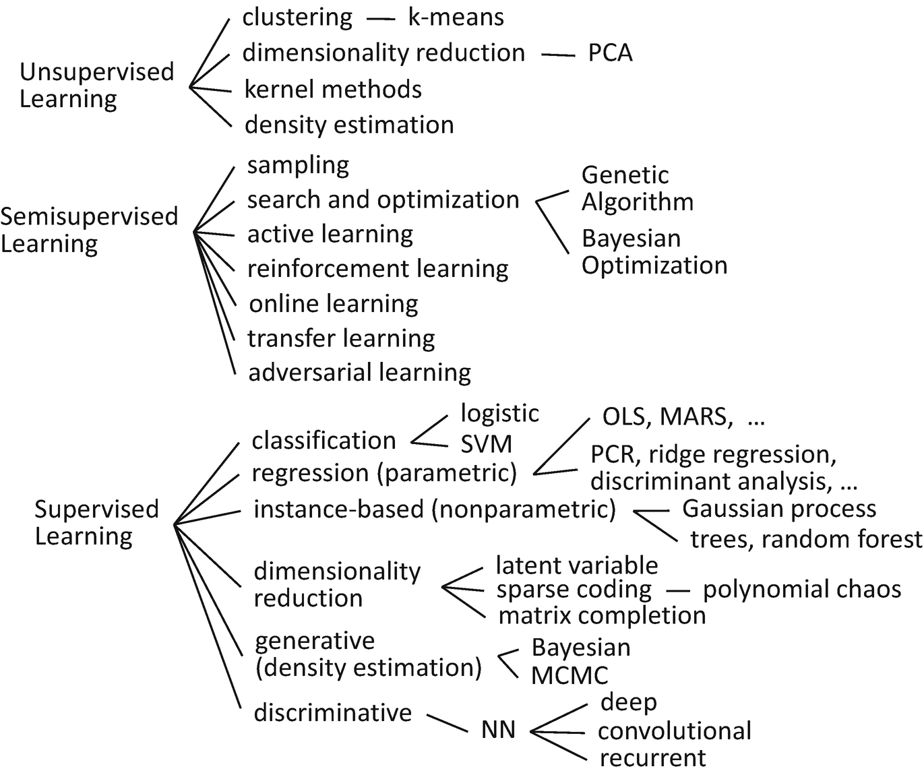

Slide 3
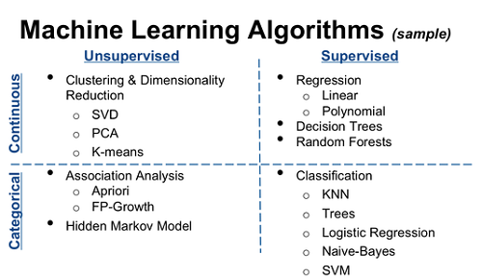

Slide 4
Linear Regression
very simple approach for supervised learning.
linear regression is a useful tool for predicting a quantitative response.
we will see some of the key ideas underlying the linear regression model, as well as the least squares approach that is most commonly used to fit this model.

Slide 5
Bivariate or simple linear regression
x is the independent variable
y is the dependent variable
The regression model is
The model has two variables, the independent or explanatory variable, x, and the dependent variable y, the variable whose variation is to be explained.
The relationship between x and y is a linear or straight line relationship.
Two parameters to estimate – the slope of the line β₁ and the y-intercept β₀ (where the line crosses the vertical axis).
ε is the unexplained, random, or error component. Much more on this later.

Slide 6
Regression line
The regression model is
Data about x and y are obtained from a sample.
From the sample of values of x and y, estimates b₀ of β₀ and b₁ of β₁ are obtained using the least squares or another method.
The resulting estimate of the model is
The symbol is termed “y hat” and refers to the predicted values of the dependent variable y that are associated with values of x, given the linear model.

Slide 7
Income | hrs/week |  | Income | hrs/week
8000 | 38 |  | 8000 | 35
6400 | 50 |  | 18000 | 37.5
2500 | 15 |  | 5400 | 37
3000 | 30 |  | 15000 | 35
6000 | 50 |  | 3500 | 30
5000 | 38 |  | 24000 | 45
8000 | 50 |  | 1000 | 4
4000 | 20 |  | 8000 | 37.5
11000 | 45 |  | 2100 | 25
25000 | 50 |  | 8000 | 46
4000 | 20 |  | 4000 | 30
8800 | 35 |  | 1000 | 200
5000 | 30 |  | 2000 | 200
7000 | 43 |  | 4800 | 30
Notes:
Discuss cleaning the data.
– 0 incomes out
– income and 0 hours out
– The 200 hours?

Slide 9
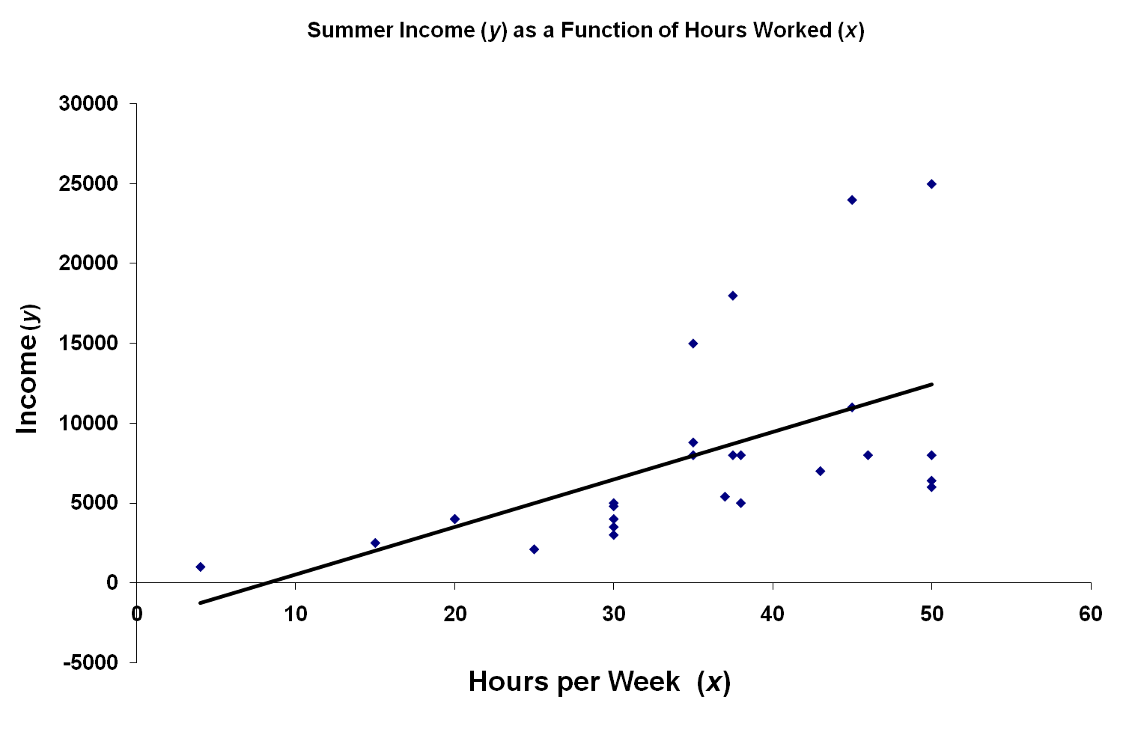
R² = 0.311
Significance = 0.0031
Notes:
Trendline shows the positive relationship.
Evidence of other variables?

Slide 10
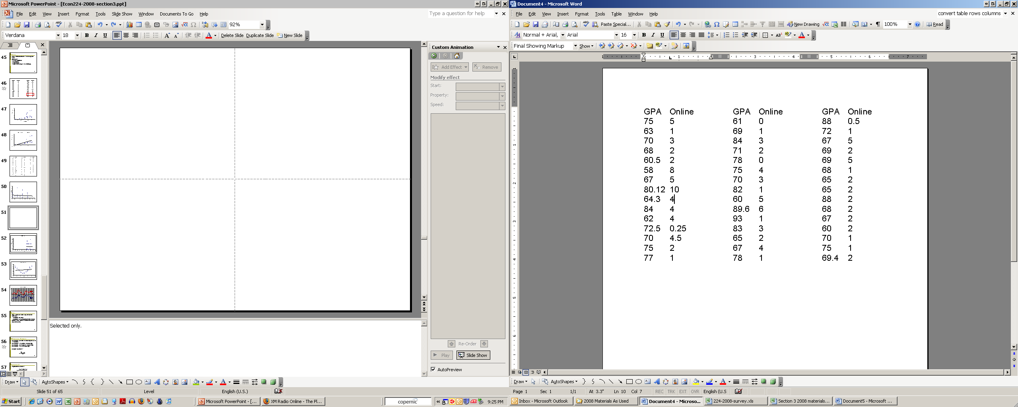
Notes:
Selected only.

Slide 11
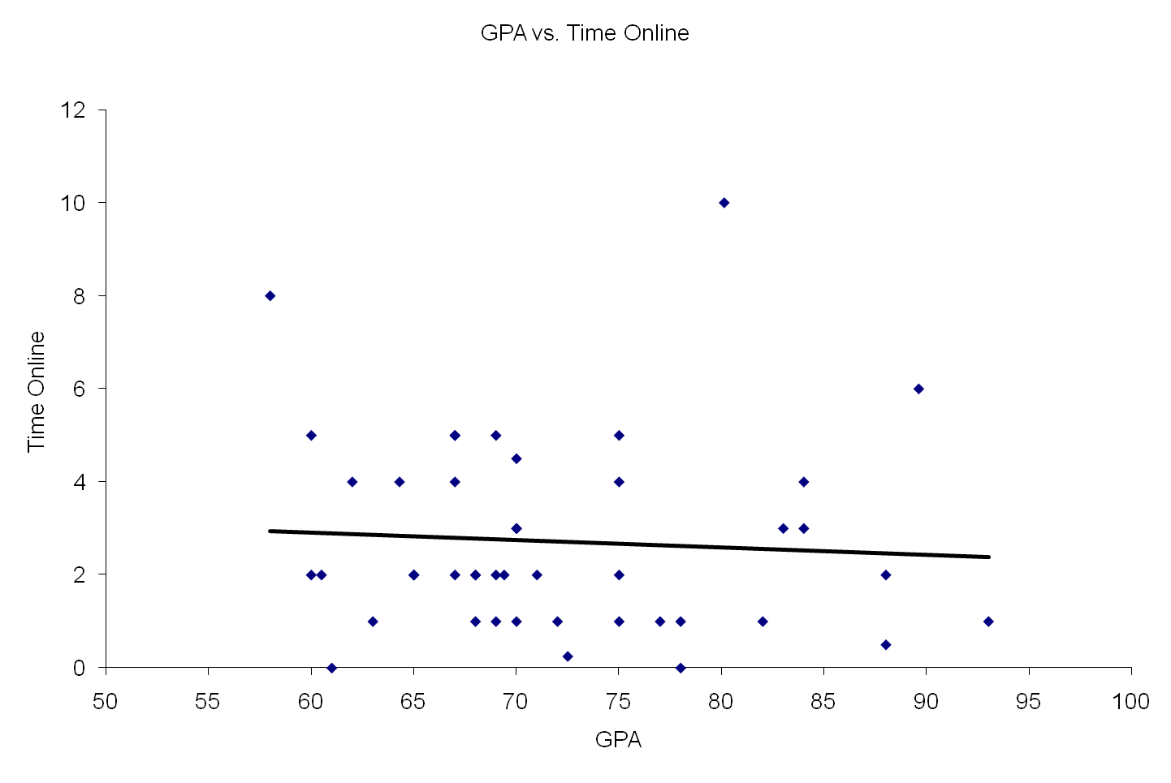
Notes:
The role of the two significant observations

Slide 12

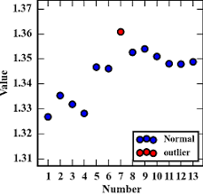
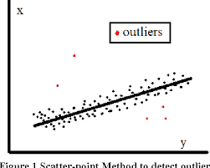
Outliers
Rare, extreme values may distort the outcome.
  Could be an error.
  Could be a very important observation.
Outlier: more than 3 standard deviations from the mean.
Notes:
If you see one, check if it is a mistake.

Slide 13
Notes:
The role of the two significant observations

Slide 14
Notes:
The role of the two significant observations

Slide 15
References & Summary
References:
  https://www.youtube.com/watch?v=orQ-QGaOPIg
  https://www.mathsisfun.com/data/least-squares-calculator.html
Summary
  Linear Regression

